Slide 1



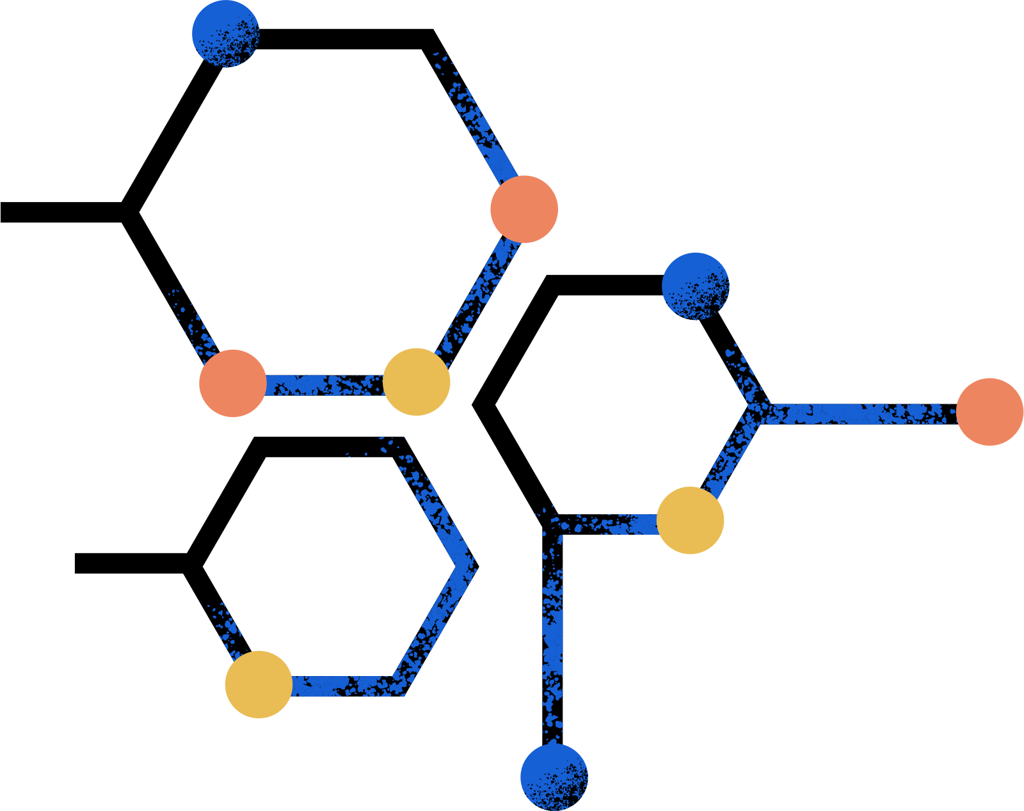


8 BIT COMPARATOR CIRCUIT DESIGN
VLSI -CMOS

Slide 2


01
OPERATING PRINCIPLE & STRUCTURAL DIAGRAM OF 8-BIT COMPARATOR

Slide 3


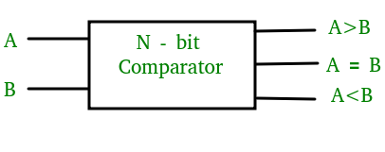
Introduction about comparator
A magnitude digital comparator is a combinational circuit that compares two binary numbers to determine whether one number is greater, less than, or equal to the other.
An 8-bit comparator can be implemented using a combination of XOR, AND, and OR gates or by using a cascaded arrangement of full adders.
The choice of implementation depends on factors such as speed, complexity, and power consumption.

Slide 4
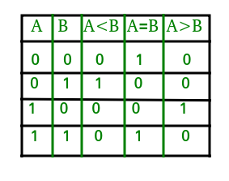
1-Bit Magnitude Comparator:
A single-bit comparator is a circuit that compares two binary numbers of a single bit. It has two inputs for the two bits to be compared and three outputs for indicating whether one bit is less than, equal to, or greater than the other.
The truth table for a 1-bit comparator

Slide 5
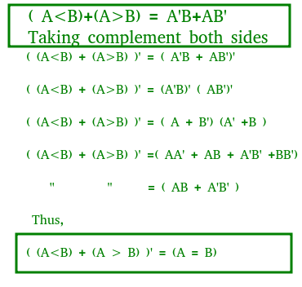

From the above truth table logical expressions for each output can be expressed as follows:
A>B: AB'
A<B: A'B
A=B: A'B' + AB

Slide 6
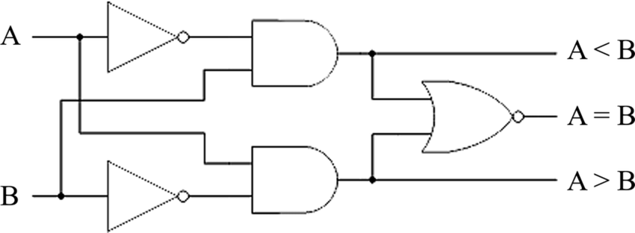
By using these Boolean expressions, we can implement a logic circuit for this comparator as given below:

Slide 7


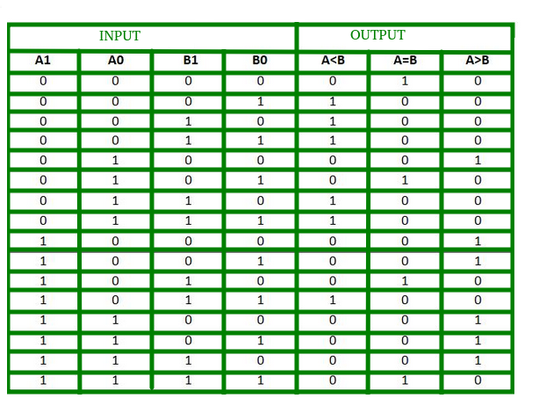

2-Bit Magnitude Comparator:
A comparator used to compare two binary numbers each of two bits is called a 2-bit Magnitude comparator. It consists of four inputs and three outputs to generate less than, equal to, and greater than between two binary numbers.

Slide 8
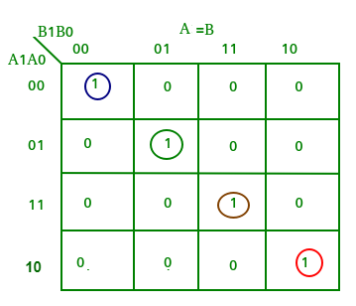
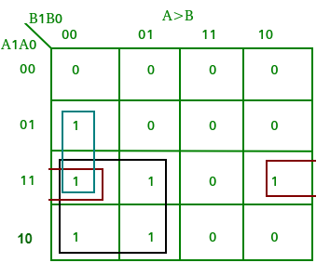
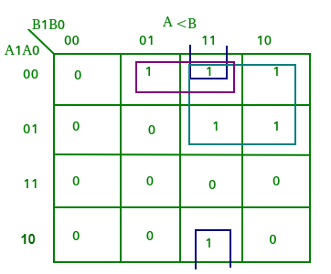


Slide 9


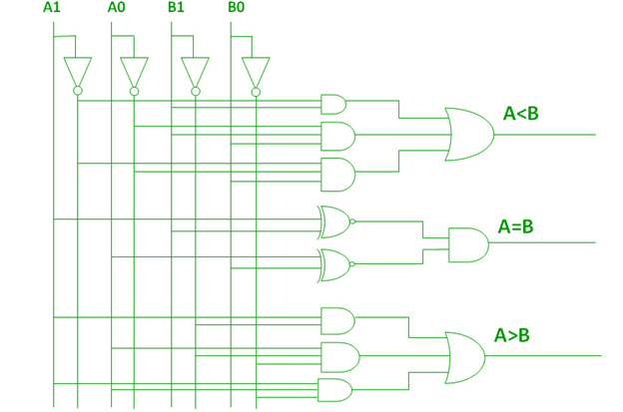
A>B:A1B1’ + A0B1’B0’ + A1A0B0’
A=B: A1’A0’B1’B0’ + A1’A0B1’B0 + A1A0B1B0 + A1A0’B1B0’
cA1’B1’ (A0’B0’ + A0B0) + A1B1 (A0B0 + A0’B0’)
(A0B0 + A0’B0’) (A1B1 + A1’B1’)
(A0 Ex-Nor B0) (A1 Ex-Nor B1)
A<B:A1’B1 + A0’B1B0 + A1’A0’B0

Slide 10


4-BIT MAGNITUDE COMPARATOR:
A 4-bit magnitude comparator is a circuit used to compare two four-bit binary numbers. It has eight inputs for the two numbers and generates three outputs for less than, equal to, and greater than comparisons
Condition of A<B
Condition of A>B
Case 1. | If A3 = 1 and B3 = 0
Case 2. | If A3 = B3 and A2 = 1 and B2 = 0
Case 3. | If A3 = B3, A2 = B2 and A1 = 1 and B1 = 0
Case 4. | If A3 = B3, A2 = B2, A1 = B1 and A0 = 1 and B0 = 0
Case 1. | If A3 = 0 and B3 = 1
Case 2. | If A3 = B3 and A2 = 0 and B2 = 1
Case 3. | If A3 = B3, A2 = B2 and A1 = 0 and B1 = 1
Case 4. | If A3 = B3, A2 = B2, A1 = B1 and A0 = 0 and B0 = 1

Slide 11
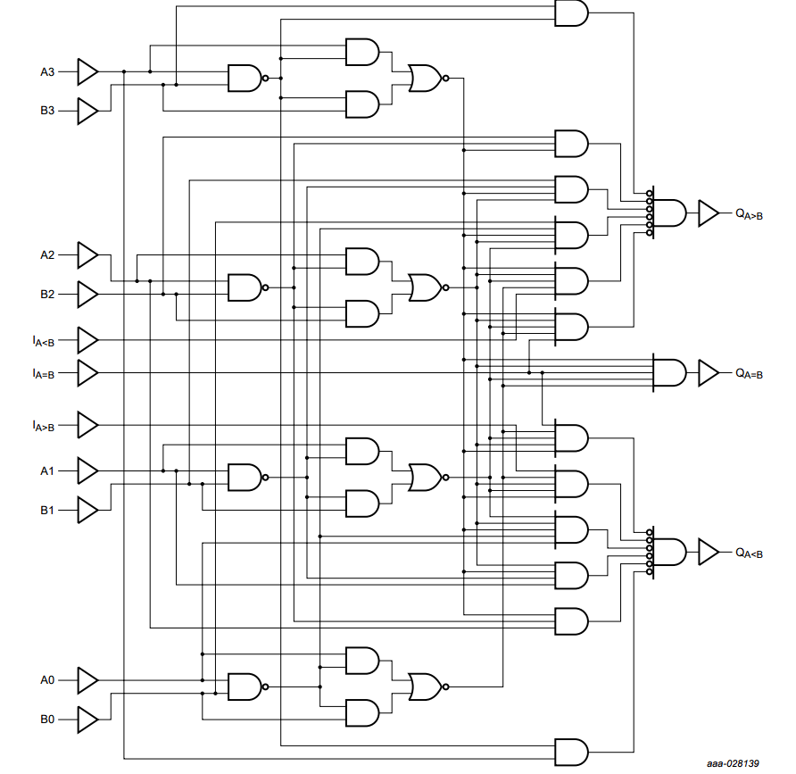

Slide 12



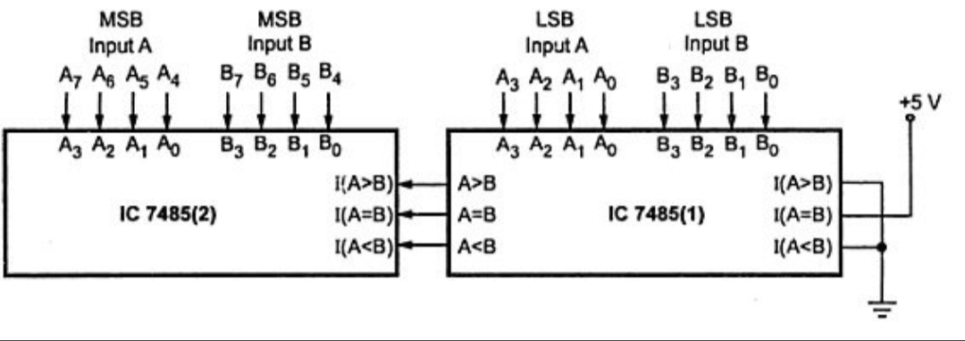


CASCADING COMPARATOR:
A comparator performing the comparison operation to more than four bits by cascading two or more 4-bit comparators is called a cascading comparator. When two comparators are to be cascaded, the outputs of the lower-order comparator are connected to the corresponding inputs of the higher-order comparator.

Slide 13



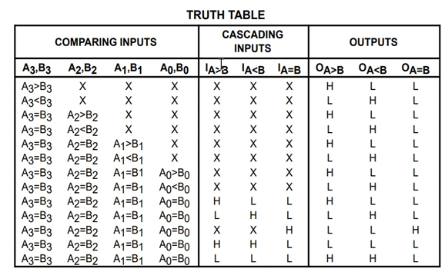

OPERATING PRINCIPLE
An 8-bit comparator can be implemented using two 74HC85 ICs, which are 4-bit magnitude comparators
The operating principle of an 8-bit comparator using two 74HC85 ICs is based on dividing the 8-bit input into two 4-bit inputs and comparing them separately using the two 74HC85 ICs

Slide 14

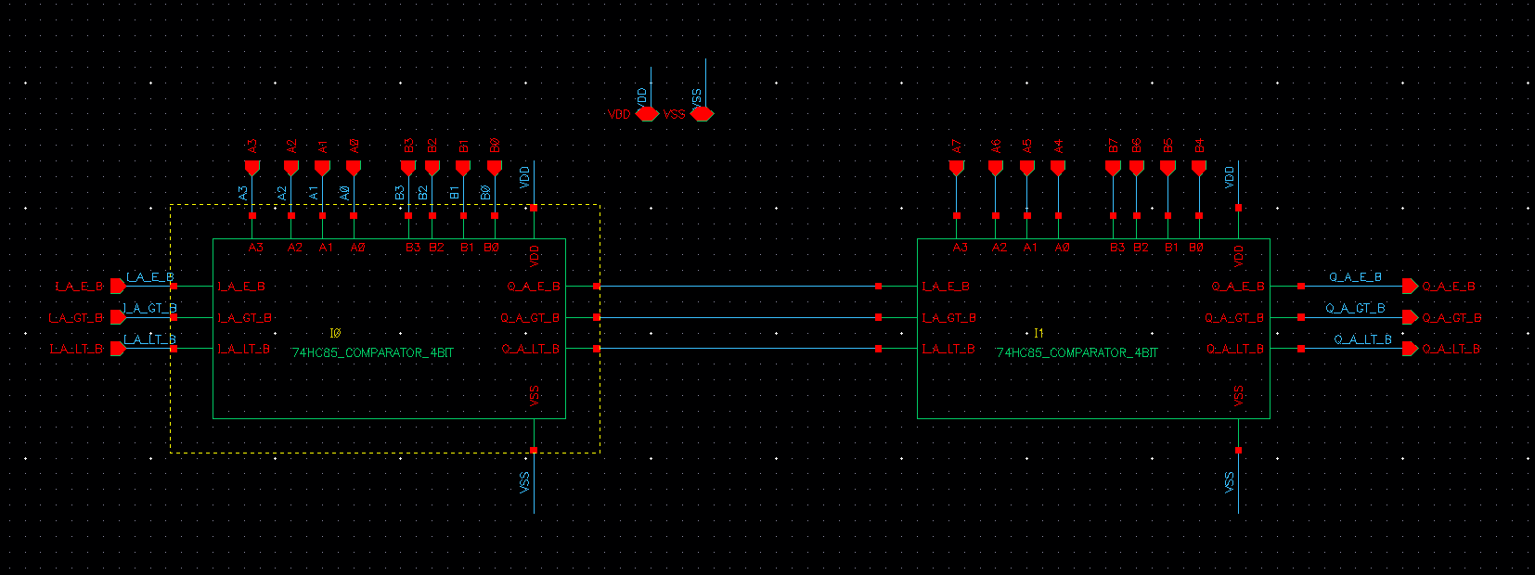

STRUCTURAL DIAGRAM
Inside of a comparator 8bit include 2 comparator 4bit

Slide 15
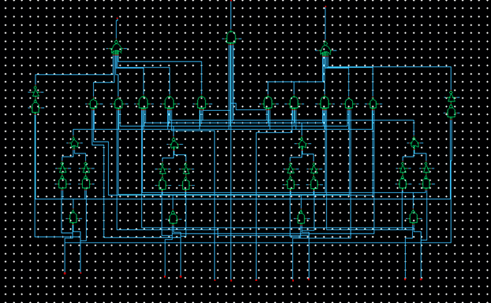
INSIDE A COMPARATOR 4BIT

Slide 16


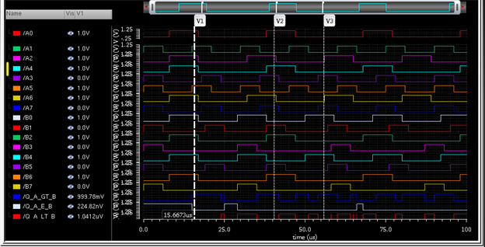

A greater than B
Case 1(V1):
A: 01101111 – DECIMAL: 11 B: 01010101 – DECIMAL: 85

Slide 17
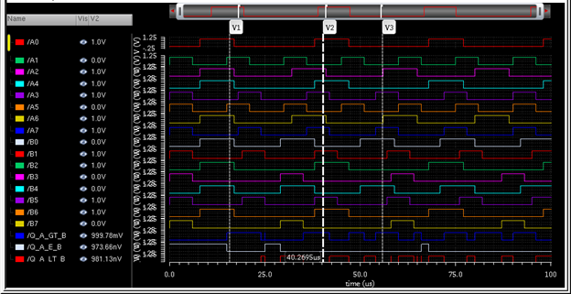
A greater than B
Case 2(V2):
A: 11011101 – Decimal: 221 B: 01100110 – Decimal: 102

Slide 18
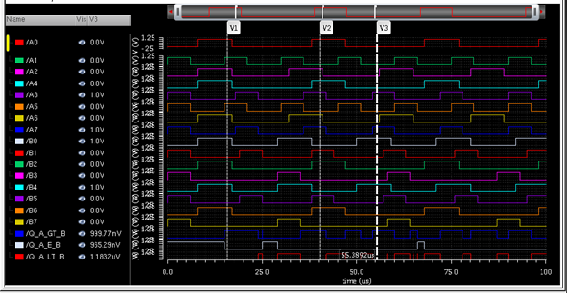
A greater than B
Case 3(V3):
A: 10010000 – Decimal: 144 B: 00010001 – Decimal: 17

Slide 19
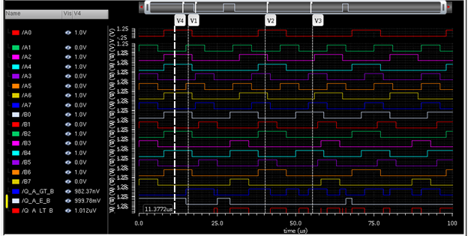
A equal to B
Case 1(V4):
A: 01001101 – Decimal: 77 B: 01001101 – Decimal: 77

Slide 20
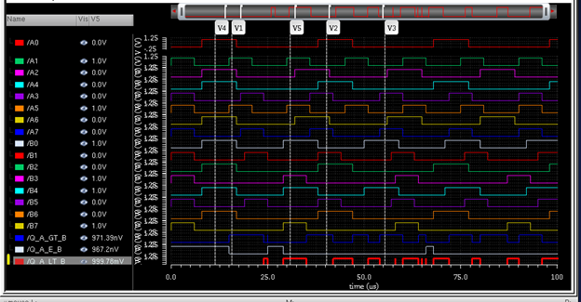
A less than B
Case 1(V5):
A: 00100010 – Decimal: 34 B: 10011001 – Decimal: 153

Slide 21
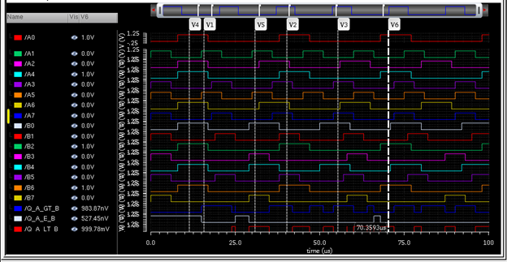
A less than B
Case 2(V6):
A: 00001001 – Decimal: 9 B: 01000100 – Decimal: 68

Slide 22
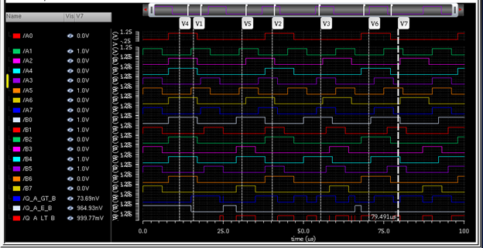
A less than B
Case 3(V7):
A: 00100010 – Decimal: 34 B: 00110011 – Decimal: 51

Slide 23
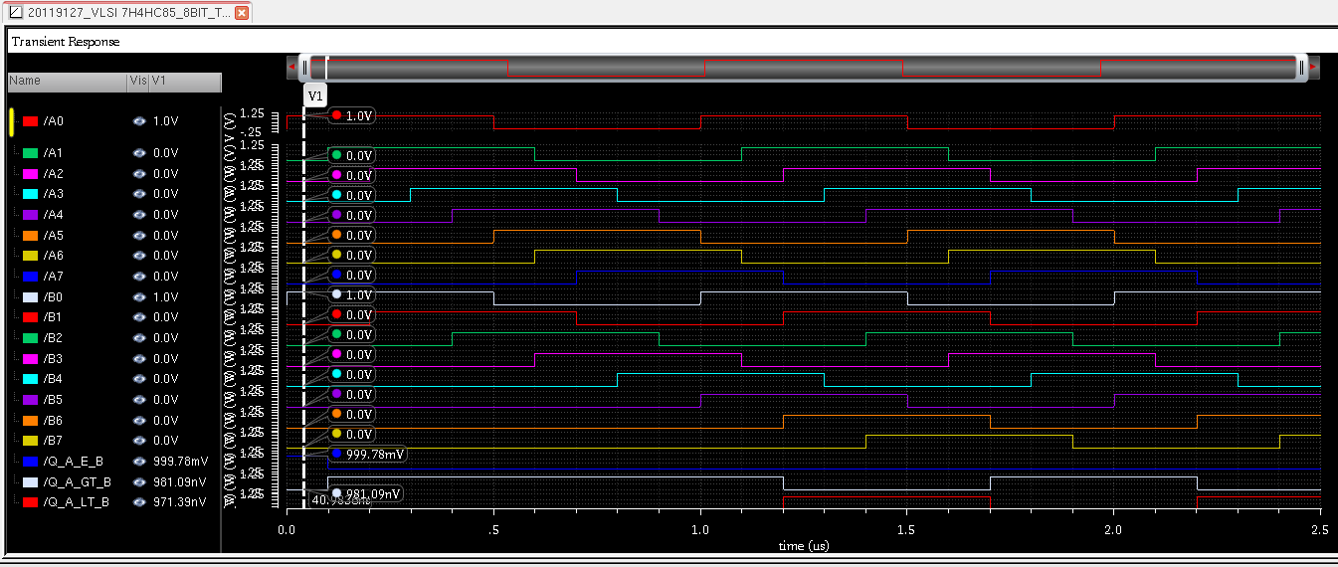
Simulation Test At frequency= 1MHz (period=1us) in 50ns
Case1: A: 0000 0001 = 1 (dec)
B: 0000 0001 = 1 (dec)

Slide 24
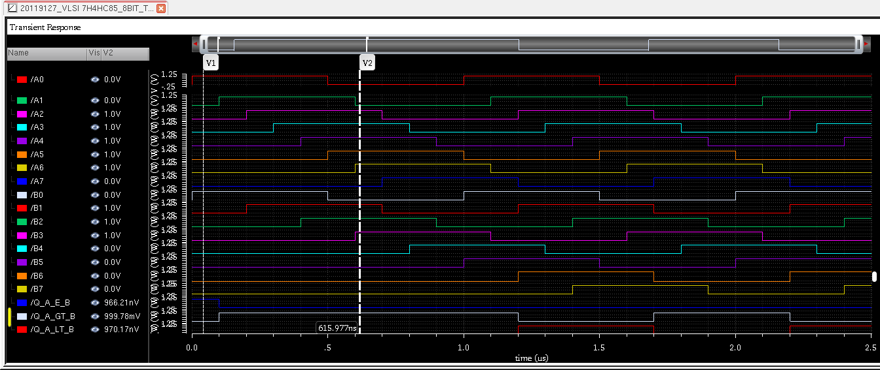
Frequency = 1MHz
Case2: A: 0111 1100 = 124 (dec)
B: 0000 1110 = 014 (dec)

Slide 25
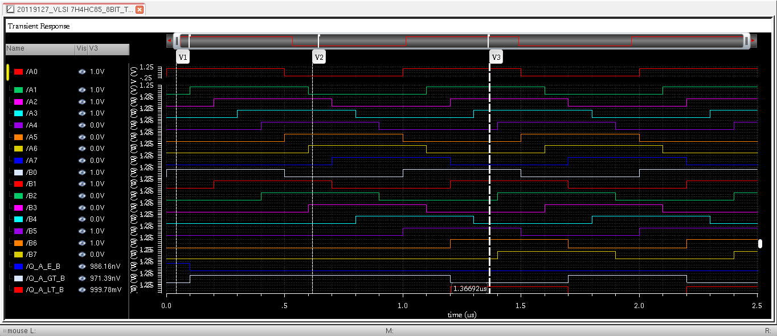
Frequency = 1MHz
Case3: A: 0000 1111 = 15 (dec)
B: 0110 0011 = 99 (dec)

Slide 26
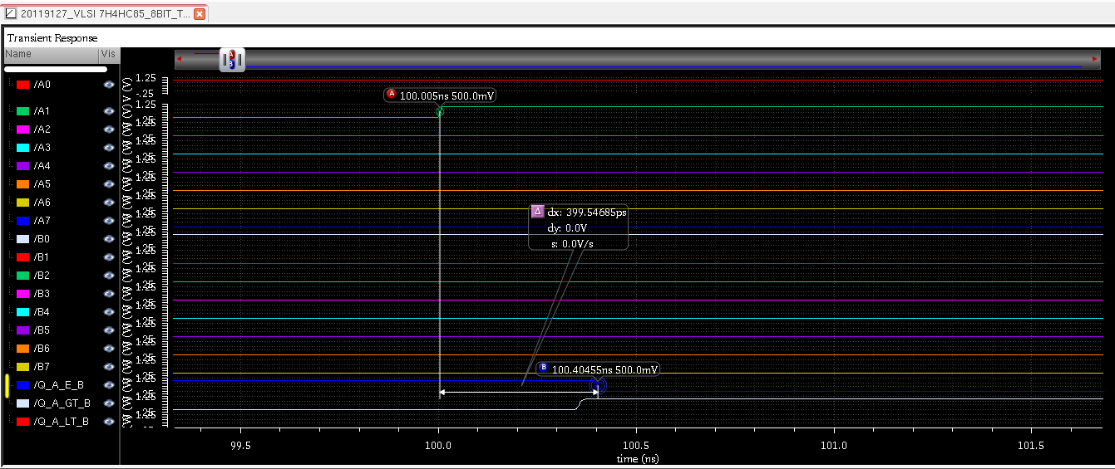
Delay time to output Q_A_E_B go Low: 399.5468ps

Slide 27
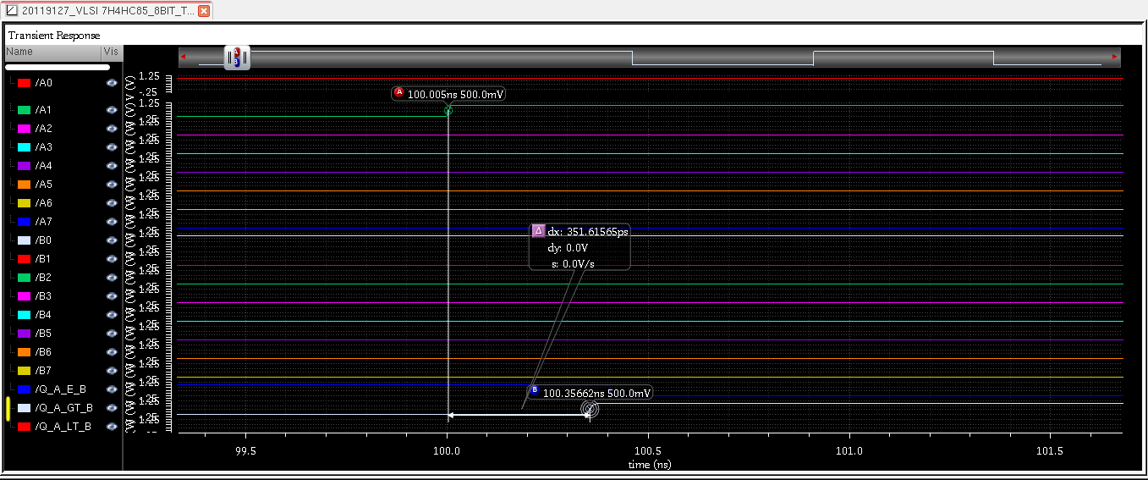
Delay time to output Q_A_GT_B go high: 351.61565ps

Slide 28
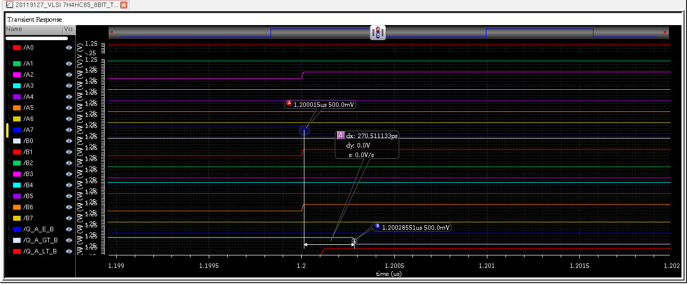
Delay time to output Q_A_GT_B go Low: 270.511133ps

Slide 29
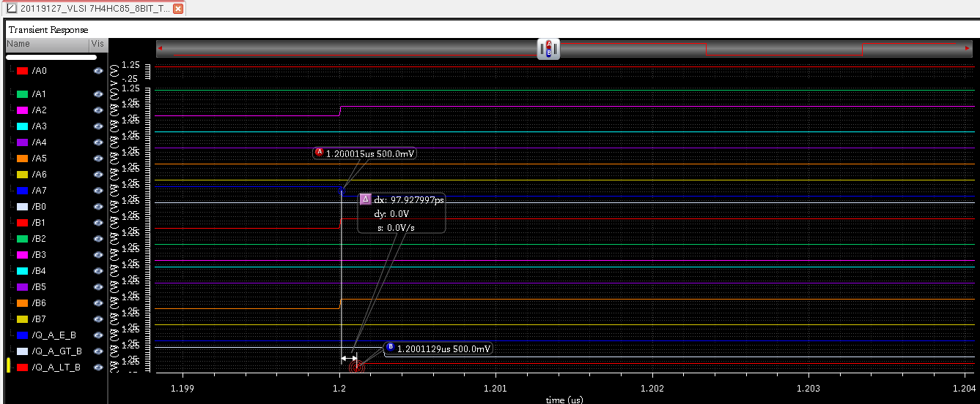
Delay time to output Q_A_LT_B go High: 97.927997ps

Slide 30
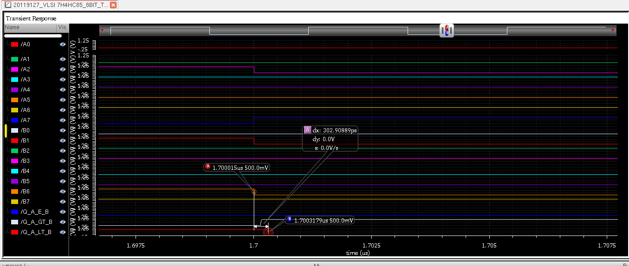
Delay time to output Q_A_LT_B go Low: 302.90889ps

Slide 31
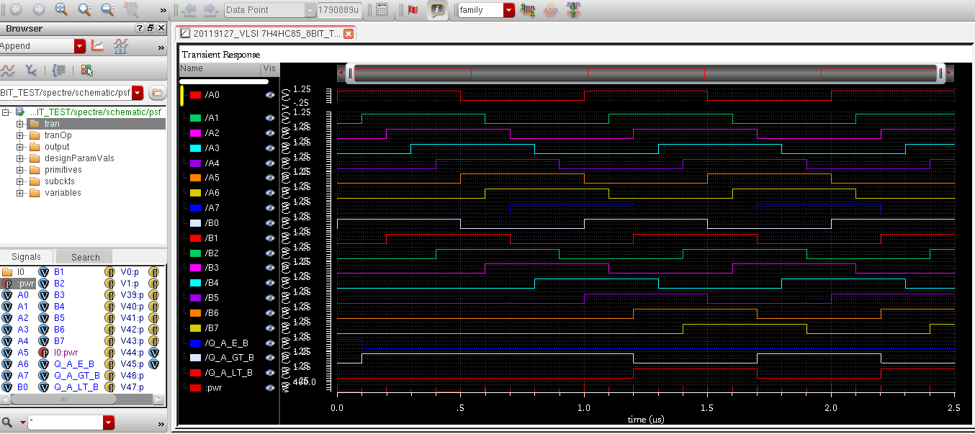

Slide 32
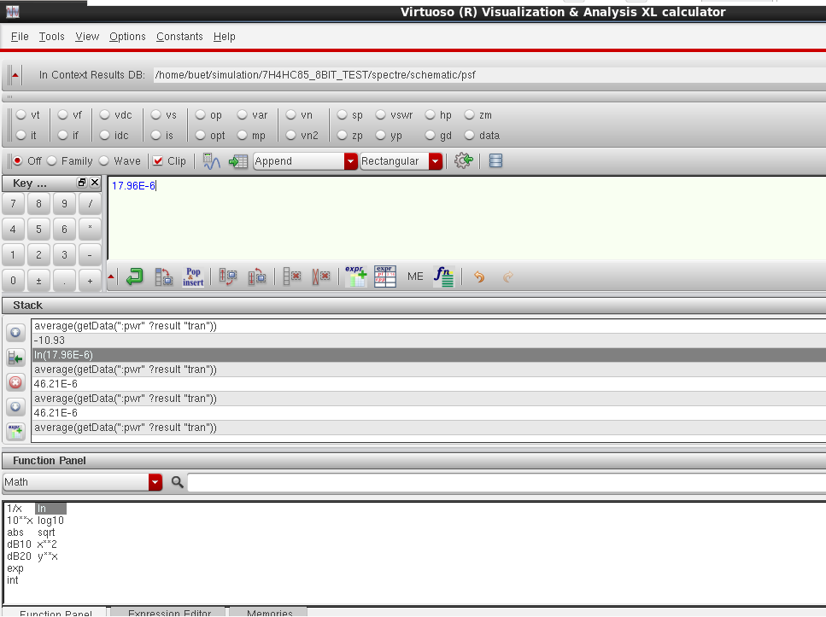
Average power consumption=17.96xE^-6 (W)

Slide 33
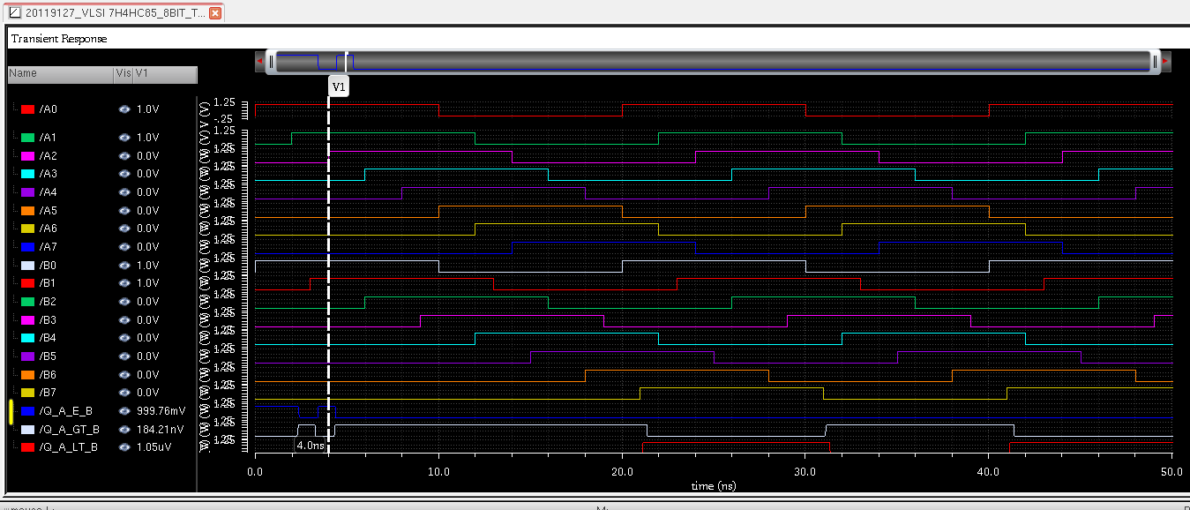
Simulation Test At frequency= 50MHz (period=20ns) in 50ns
Case1: A: 0000 0011 = 3 (dec)
B: 0000 0011 = 3 (dec)

Slide 34
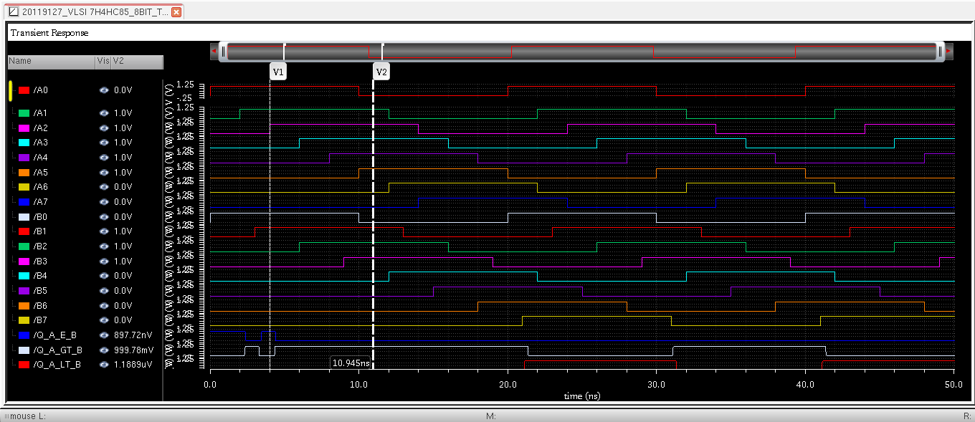
Frequency = 50MHz
Case2: A: 0011 1110 = 62 (dec)
B: 0000 1110 = 14 (dec)

Slide 35
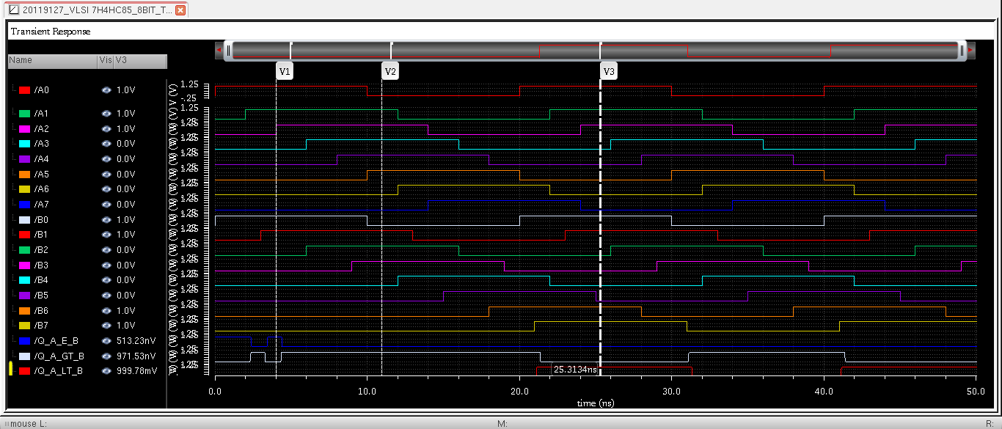
Frequency = 50MHz
Case3: A: 0000 0111 = 007 (dec)
B: 1100 0011 = 195 (dec)

Slide 36
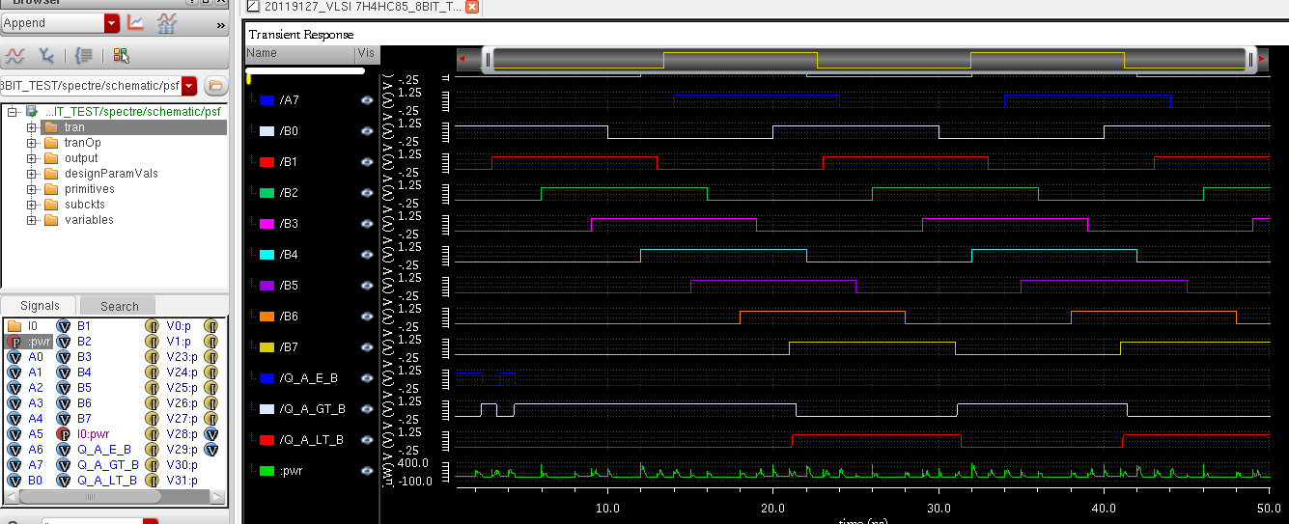

Slide 37
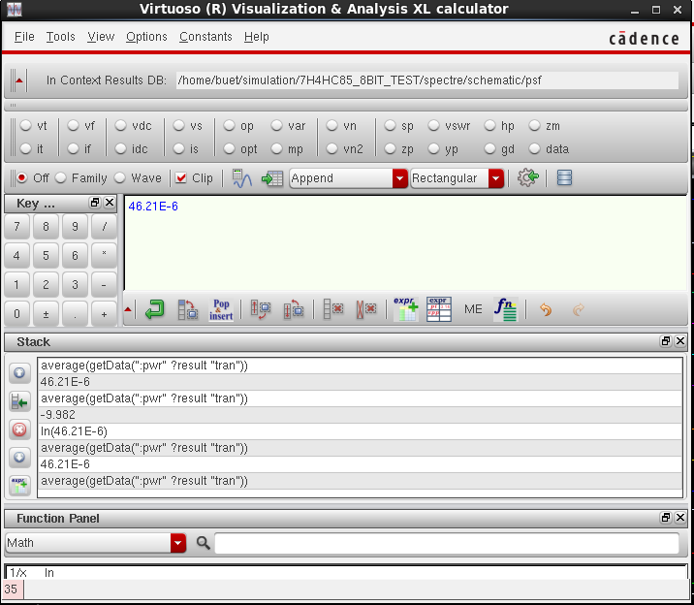
Average Power Consumption P(average)=46.21xE^(-6) (W) Higher than average power at 1Mhz

Slide 38


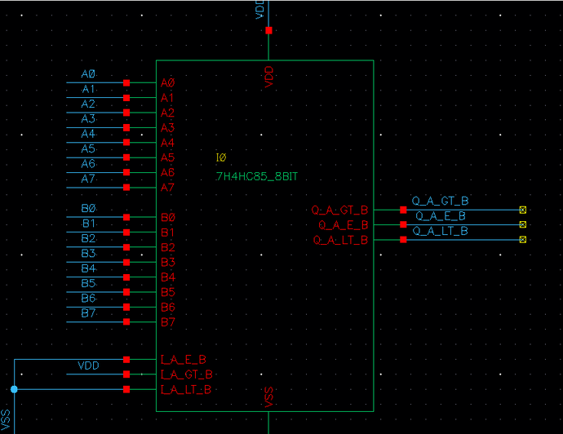

CONCLUSION AND APPLICATION
The 74HC85 is a 4-bit magnitude comparator IC that can be used to construct an 8-bit comparator by combining two ICs. The inputs are split into two groups of four bits each, and the outputs of each 74HC85 are combined to produce a result.
The 8-bit comparator is commonly used in digital signal processing, arithmetic operations, and data encoding. It is particularly useful in designing circuits that perform arithmetic operations on 8-bit numbers, where it can determine the relative magnitudes of two operands and select the appropriate operation.

Slide 39
CONCLUSION AND APPLICATION
The 8-bit comparator is also useful in data encoding, where it can be used to encode the relative magnitudes of multiple 8-bit binary numbers into a smaller number of bits. For example, it can be used in a priority encoder to output the highest-priority input as a binary code.
Overall, the 8-bit comparator using two 74HC85 ICs is a versatile and popular choice for many digital circuit designs due to its small size, low power consumption, and fast operation.

Slide 40





Design of 12-bit Digital Comparator Using Multiplexer for High-Speed Application in 32-nm CMOS Technology

Slide 41
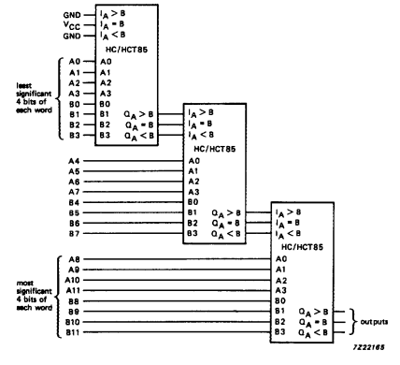
12-bit comparator
Structure:

Slide 42

Searching A Novel Design of 12-bit Digital Comparator Using Multiplexer for High Speed Application in 32-nm CMOS Technology.
The paper discusses the importance of power consumption in digital CMOS circuits and the use of different methodologies for designing low-power circuits with small size and high-speed interfaces. It emphasizes the impact of wiring complexity on the area of an integrated circuit and the significance of selecting the right logic style for circuit performance.
The paper presents the design of a 12-bit comparator with low power consumption and improved packing densities using a multiplexer-based approach and a novel technique. The design is implemented in 32-nanometer technology with a supply voltage of 0.7 V, targeting applications such as Digital Signal Processing, Central Processing Unit, and Microcontroller.

Slide 43
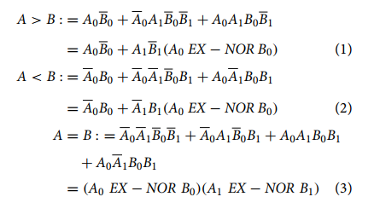
Two-bit digital comparator
The comparator checks the relative magnitude of two signals from the most significant bit to the next successive bit. If the most significant bits are not equal, it decides whether A is greater than or less than B.

Slide 44
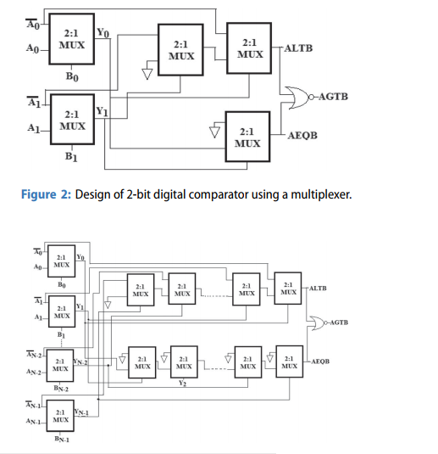
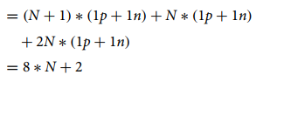
Two-bit digital comparator using a multiplexer
Number of transistors required = (N + 1) number of IInverter + N number of 2:1 MUX for block-1 + 2N number of MUX for block-2

Slide 45
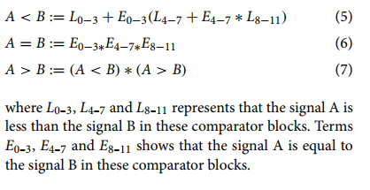
Novel technique for high-speed digital comparator

Slide 46
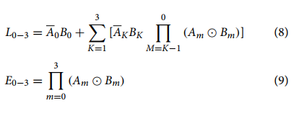
Novel technique-based 12-bit comparator design details

